Slide 1

Workpshop

Slide 2
BUILD ?
Build is a social platform
APP Prototyping, no UI experience.
Test your idea for the design of an app without having to code
evaluate if a design would be accepted
It’s basically created to be of help in UX design testing.

Slide 3
DESIGN THINKING
Is a new, fresh way of engaging with SAP to find human meaning and use for technology.
Helps you think differently about: B
Business, P
Pain points E
Explore the unknown
Innovate.

Slide 4
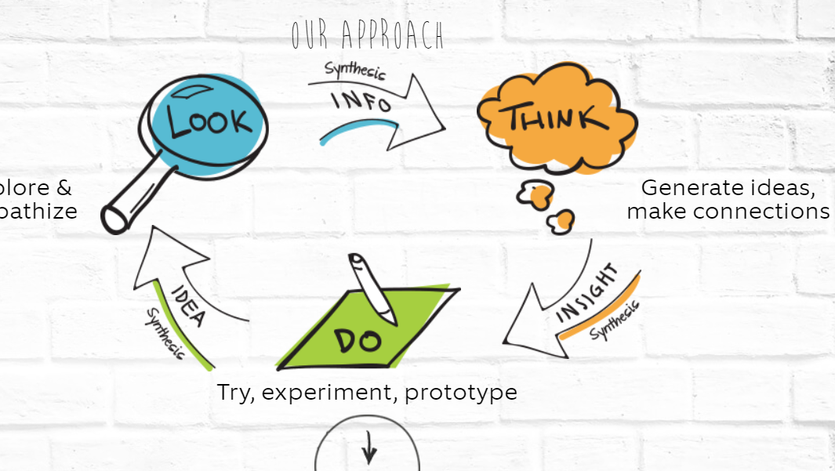
How it works

Slide 5
GO TO GITHUB !
https://github.com/raam2099/SAP-BUILD

Slide 6
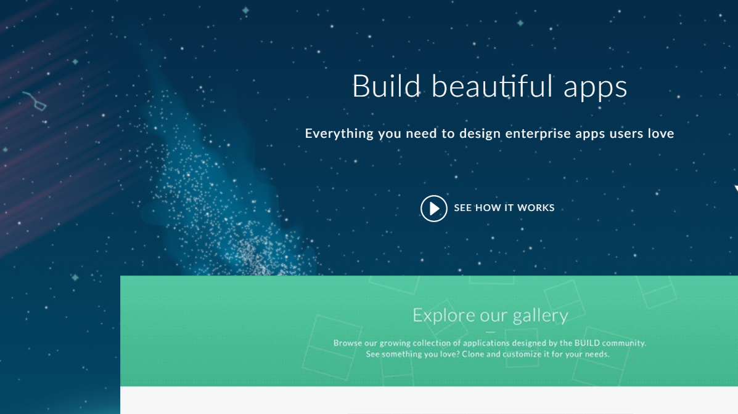
How to start?
Please log in:
https://www.build.me/splashapp/

Slide 7
More on BUILD and Design thinking ?
https://blogs.sap.com/2016/11/03/build-overview/
1
https://designthinkingwithsap.com/en/
2

Slide 8
ASUG
For 25 years, our members have been at the forefront of digital transformation, and they have always had the company of fellow visionaries and pioneers who understood the potential of SAP technology and the path ahead.
ASUG isn’t a place or a thing. It’s a connection—between professionals seeking the best ideas, answers, and advice on how to stay ahead of an ever-evolving technology landscape.
https://www.asug.com/about

Slide 9
ASUG presentation
NOVEMBER THE 6TH
^{Volunteers ?}
^{Let me know after the workshop}

